Slide 1
Model Calibration and Validation
BSEN 5250/6250
References
Mayer and Butler, 1992

Slide 2
Large Models
Typically have a graphical user interface
Have numerous inputs
Describe many physical or biological processes
Integrate processes together over time
Describe interactions between processes
Provide numerous outputs
Often have graphics to analyze outputs
Up to half of the code may be related to reading inputs and creating outputs

Slide 3
Structure of Large Models
Divides model into modules to simplify maintenance of code
Modules may have multiple subroutines
Subroutine represents a process or groups of related processes
May follow a “modular” programming process where a module reads its own inputs, integrates the state equations, updates state variables, and writes its own output. This allows users to plug in similar modules from other researchers for evaluation.

Slide 4
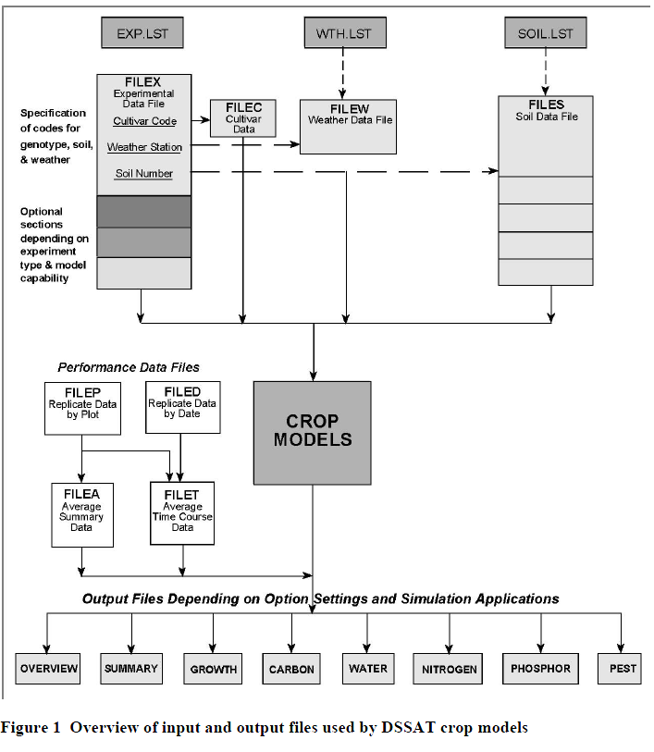
Structure of the DSSAT family of crop growth models
Inputs Files
Measured Data for Calibration and Validation
Crop Models
Output Files

Slide 5
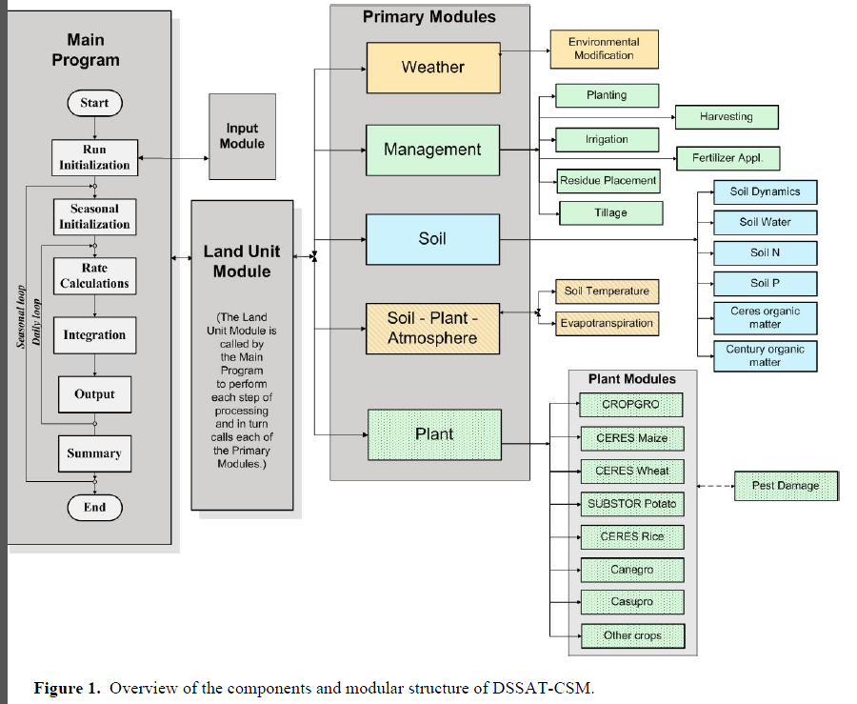
Structure of the DSSAT family of crop growth models

Slide 6
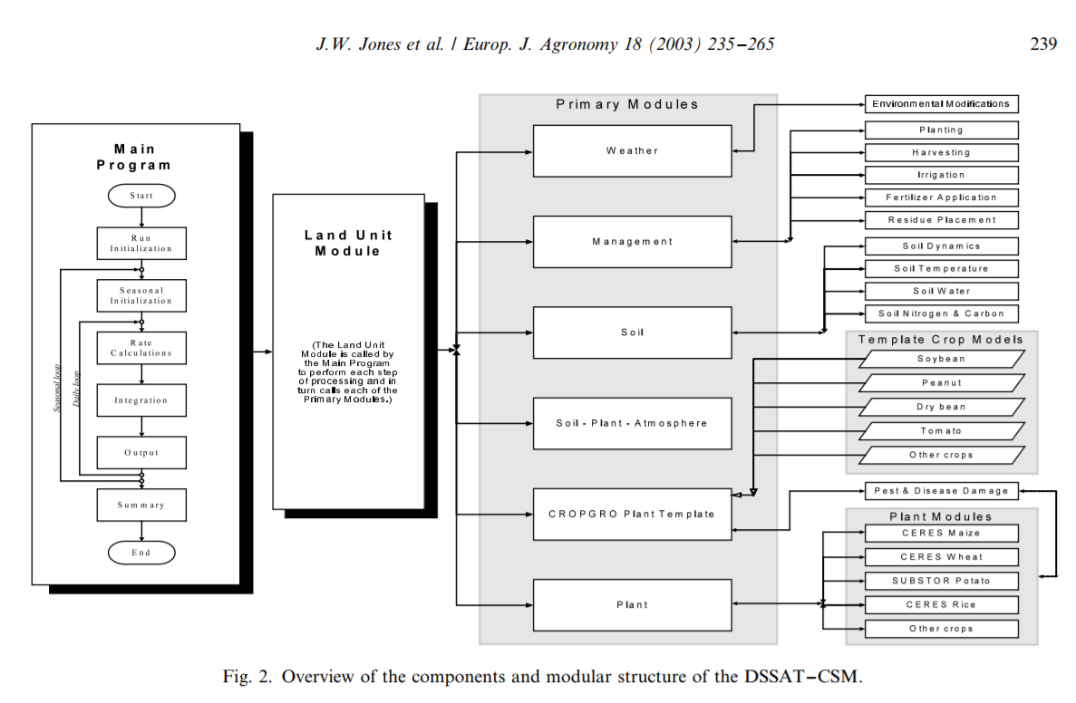

Slide 7
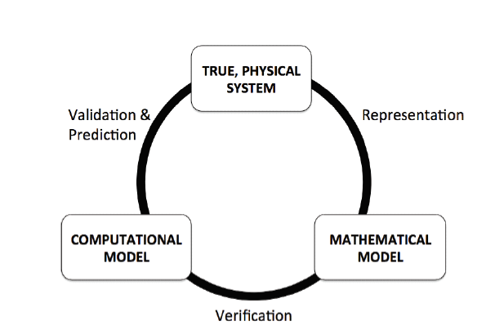
Model Verification
Confirming the code does exactly what is desired
Requires detailed checking of each process
Code is never “perfect” (ie. hacking)

Slide 8
Calibration
Many model parameters may be unknown or initially estimated based on field measurements or literature values
Parameter calibration may be needed to adjusted the model to minimize error
Calibration can be performed by trial and error, or through an optimizer. Some complex models provide optimizers to aid the user in parameter estimation.
Calibration may be very site specific

Slide 9
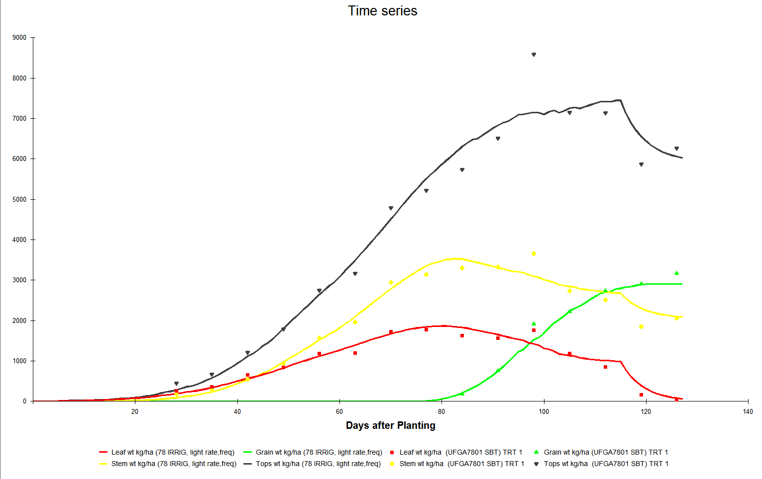
Visual Quantification of Error for Time Series Data
Top weight
Grain weight
Stem weight
Leaf weight

Slide 10
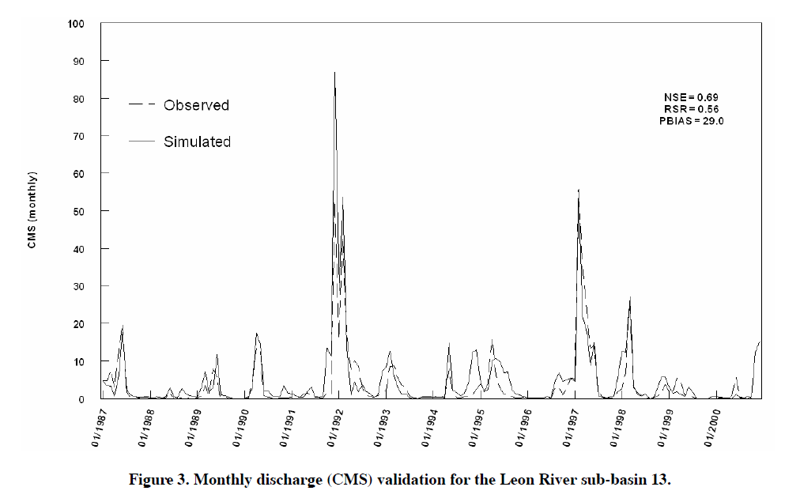
Visual Quantification of Error for Time Series Data

Slide 11
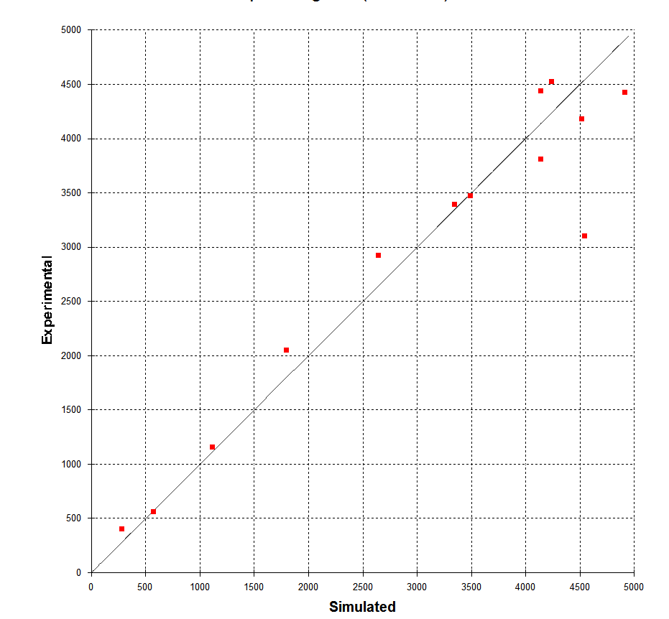
Visual Quantification of Error for Simulated vs Observed Data
Shows trends in error (low vs high values)
Compare model across large number of experiments

Slide 12
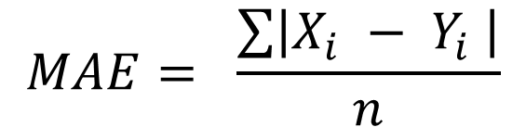
Statistical Quantification of Error
Mean Absolute Error
Simulated and observed data can be paired according to time, location, treatment, etc.
MAE is in same units as the data
Positive and negative errors do not cancel each other out.
$$MAE= \frac{\sum{\left|X_{i} − Y_{i} \right|}}{n}$$
MAE = mean absolute error
n = number of data pairs
X_{i} = observed value of i^{th} observed value
Y_{i} = simulated value of i^{th} observed value

Slide 13
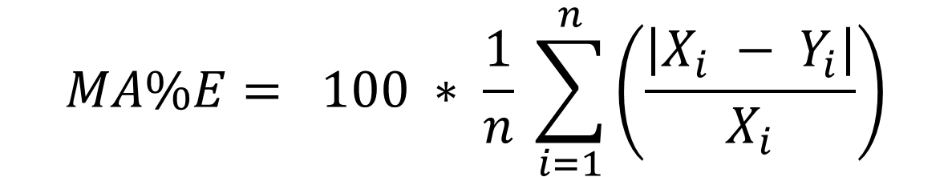
Statistical Quantification of Error
Mean Absolute Percent Error
$$MA\%E= 100 ∗ \frac{1}{n} \sum_{i=1}^{n}{\left(\frac{\left|X_{i} − Y_{i}\right|}{X_{i}}\right)}$$
Simulated and observed data can be paired according to time, location, treatment, etc.
MA%E is expressed as a relative percent error.
Sensitive to very low values of Y_{i}
MA%E = mean absolute percent error
n = number of data pairs
X_{i} = observed value of i^{th} observed value
Y_{i} = simulated value of i^{th} observed value

Slide 14
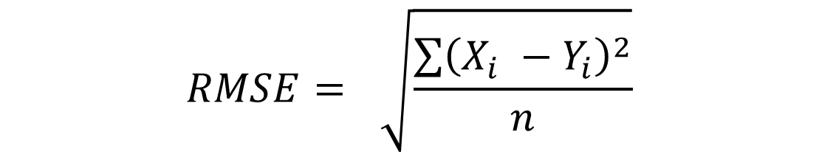
Statistical Quantification of Error
Root Mean Square Error
Units are same as data.
Positive and negative errors do not cancel each other out.
$$RMSE= \sqrt{\frac{\sum{{\left(X_{i} −Y_{i}\right)}^{2}}}{n}}$$
RMSE = root mean square error
n = number of data pairs
X_{i} = observed value of i^{th} observed value
Y_{i} = simulated value of i^{th} observed value

Slide 15
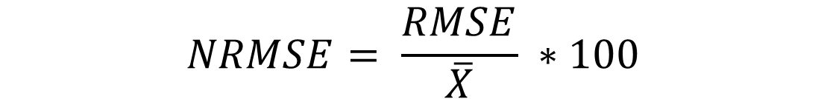
Statistical Quantification of Error
Normalized Root Mean Square Error
$$NRMSE= \frac{RMSE}{\overline{X}} ∗100$$
NRMSE = root mean square error
X̅̅ = mean of observed values
NRMSE < 15% represents “good” agreement
NRMSE between 15-30% represents “moderate” agreement
NRMSE > 30% represents “poor” agreement

Slide 16
Coefficient of Determination (R² or r²)
Definition: the proportion of the variance in the measured values that is predictable by the model
Provides indication of goodness of fit between simulated and observed values
R² ranges from 0 (no correlation) to 1.0 (perfect correlation)

Slide 17
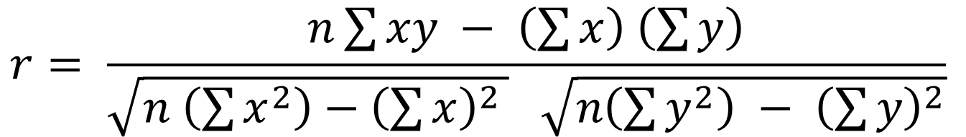
Correlation Coefficient (r)
$$r= \frac{n\sum{xy − \left(\sum{x}\right) \left(\sum{y}\right)}}{\sqrt{n \left(\sum{x^{2}}\right)−{\left(\sum{x}\right)}^{2 }} \sqrt{n\left(\sum{y^{2}}\right) − {\left(\sum{y}\right)}^{2}}}$$
r = correlation coefficient
n = number of data pairs
X = value of measured data point
Y = value of simulated data point
R (or r) Ranges from -1 to +1

Slide 18
Correlation Coefficient (r)
r = 0.902

Slide 19
Correlation Coefficient (r)
N | Measured Yield, kg/ha | Simulated Yield, kg/ha | X*Y | X^2 | Y^2
1 | 8,436 | 8,652 | 72,988,272 | 71,166,096 | 74,857,104
2 | 7,258 | 6,200 | 44,999,600 | 52,678,564 | 38,440,000
3 | 6,425 | 7,100 | 45,617,500 | 41,280,625 | 50,410,000
4 | 4,096 | 3,500 | 14,336,000 | 16,777,216 | 12,250,000
5 | 3,027 | 1,000 | 3,027,000 | 9,162,729 | 1,000,000
6 | 2,200 | 3,500 | 7,700,000 | 4,840,000 | 12,250,000
Sum | 31,442 | 29,952 | 188,668,372 | 195,905,230 | 189,207,104
r = 0.902
r² = 0.8137

Slide 20
Correlation Coefficient (r)
r = 0.902
r² = 0.8137
Measures strength and direction of linear relationship between simulated and measured values plotted against each other
Correlation coefficient r = 0.902
Ranges between -1 (perfect negative correlation) to +1 (perfect positive correlation)
If r=0 then no correlation exists between simulated and observed data
Correlation greater than 0.8 is generally described as strong
Environmental models may expect correlations of 0.6

Slide 21
Coefficient of Determination (r²)
r = 0.902
r² = 0.8137
Proportion of variance of simulated values compared to measured values
Ratio of variation explained by the model to total variation between simulated and measured values
Ranges from 0 (no variance in measured data is explained by model) to 1.0 (100% of variance in measured data is explained by model)
If r² = 0.8, this means that 80% of the variation in the data can be explained by the model, while the remaining 20% of variation cannot be explained
Spreadsheet Model Calibration and Validation.xlsx Example 1

Slide 22
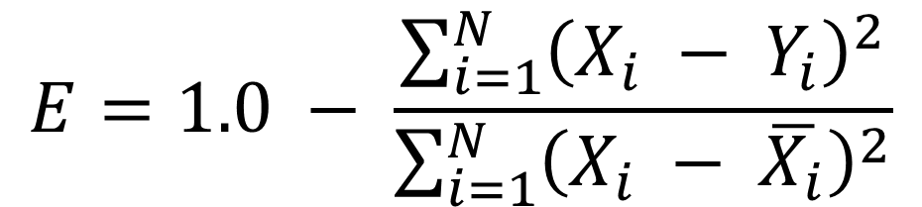
Model Efficiency – Nash-Sutcliffe Efficiency Coefficient
Often used to describe accuracy of hydrologic models
$$E=1.0 − \frac{\sum_{i=1}^{N}{{\left(X_{i} − Y_{i}\right)}^{2}}}{\sum_{i=1}^{N}{{\left(X_{i} − \overline{X_{i}}\right)}^{2}}}$$
Mean Square Error
Variance
E = model efficiency, negative infinity to 1.0 (1.0 is perfect model fit)
X_{i} = measured value of the i^{th} observation
Y_{i} = simulated value of the i^{th} observation
X̅̅_{I} = average of measured values
N = number of observations
If E < 0, the observed mean is a better predictor than model

Slide 23
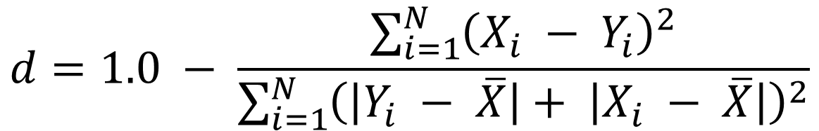
Index of Agreement (d)
$$d=1.0 − \frac{\sum_{i=1}^{N}{{\left(X_{i} − Y_{i}\right)}^{2}}}{\sum_{i=1}^{N}{{\left(\left|Y_{i} − \overline{X}\right|+ \left|X_{i} − \overline{X}\right|\right)}^{2}}}$$
d = index of agreement, 0-1.0
X_{i} = measured value of the i^{th} observation
Y_{i} = simulated value of the i^{th} observation
X̅̅_{I} = average of measured values
N = number of observations
Model performed well as d approaches 1.0
Sensitive to outliers

Slide 24
Evaluation or Validation
Purpose of validation is to determine how a model calibrated under one set of locations or conditions performs under a different set of conditions or locations
Validation should occur on different dataset and conditions than calibration
Validation may show weaknesses in the model that were hidden through calibration
A typical research project (and technical paper) would include model calibration and subsequent evaluation

Slide 25
Sensitivity Analysis
Models are a simplification of real world processes and systems
Model parameters and inputs have a degree of uncertainty about them
measurement error
lack of information
poor temporal or spatial resolution
Model outputs are sensitive to model inputs, parameters and mathematical processes
Sensitivity analysis shows how much each input or parameter contributes to the output of a model

Slide 26
Types of Sensitivity Analysis
Local Sensitivity Analysis – vary inputs around some expected mean value
Global sensitivity analysis – vary inputs over expected range

Slide 27
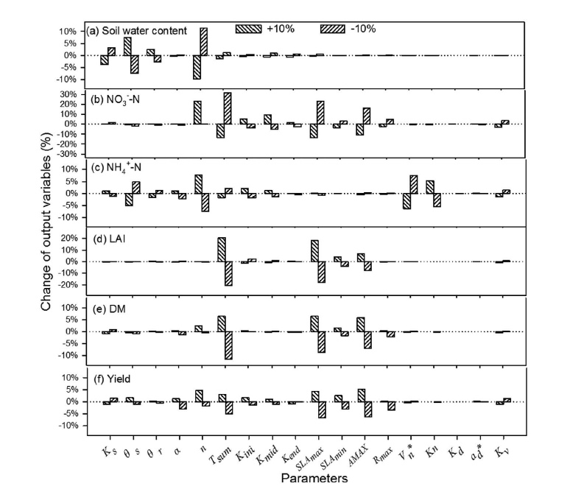
WHCNS Model
Example: Percent change in output vs percent change in input
Vary input by +/- 5, 10, 15, 20% and show impact on output
Scientific Reports | 6:25755 | DOI: 10.1038/srep25755

Slide 28
Sensitivity Analysis
Shows how sensitive the model is to different inputs and parameters
Determine if model should be sensitive to certain inputs and parameters
Make careful measurements of sensitive inputs and parameters

Slide 29
Sources of Error
Inputs
Measured data
Model theory
Code error

